Slide 1
Google Classrooms, Docs, Meet & Zoom
ONLINE SKILLS

Slide 2
Creating a google classroom
Sign in to your Gmail (preferably cemastea email)
Click on the Google apps icon, then select the classroom app
You will be taken to your classes
Click + icon to create or join a class
Select create class

Slide 3
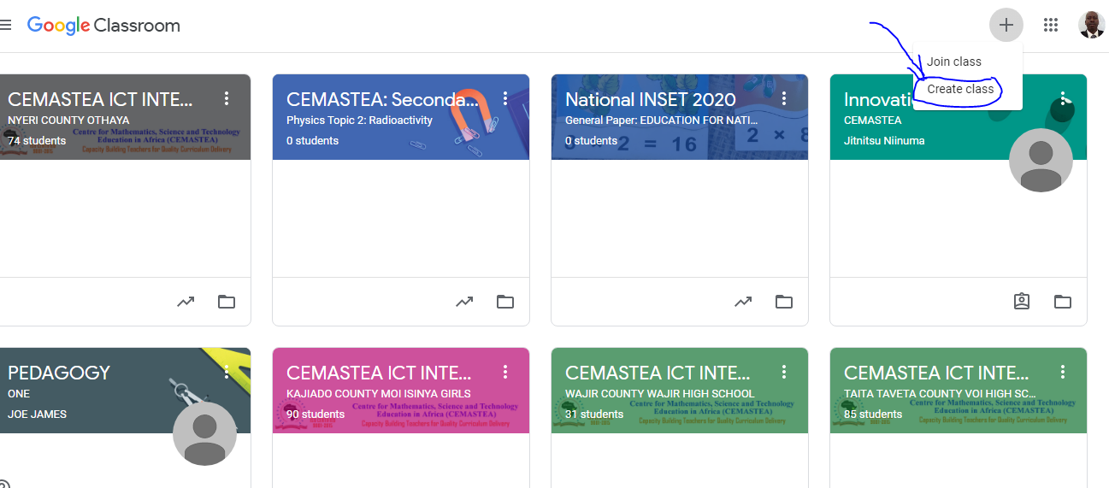
How to create a Google class

Slide 4
Google meet
When in your class click the gear icon
On the window that opens, scroll down to “General” then under ‘meet’ click “Generate meet link”
You can share the link with your students so that you can teleconference at an appropriate time (you may use Google calendar to schedule the meeting)

Slide 5
Google Docs, sheets, forms …
Go to google drive ( via the google apps)
To create a new doc, click the + sign and select Google Docs
Do the same for forms, sheets, drawing, etc.

Slide 6
Zoom
Click Meetings, and click Schedule A New Meeting.
Select the meeting options. Note that some of these options might not be available if they were disabled and locked to the off position at the account or group level. Topic: Enter a topic or name for your meeting. ...
Click Save to finish.

Slide 7
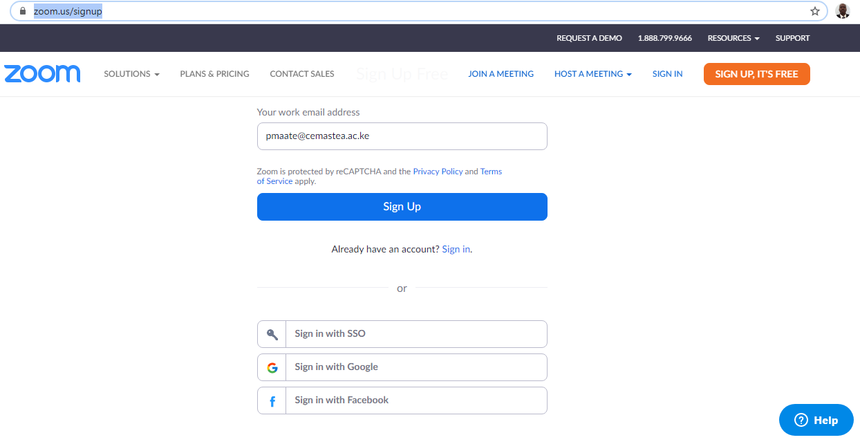
Zoom
Sign up to the Zoom web portal (on your browser) if you do not have an existing account
Follow the link https://zoom.us/signup and sign up to create an account

Slide 8
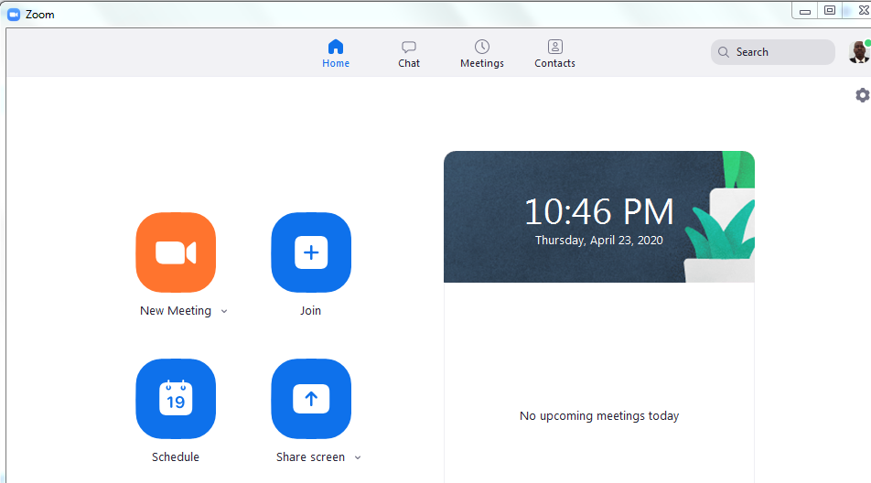
Once signed up log in to get the following window

Slide 9
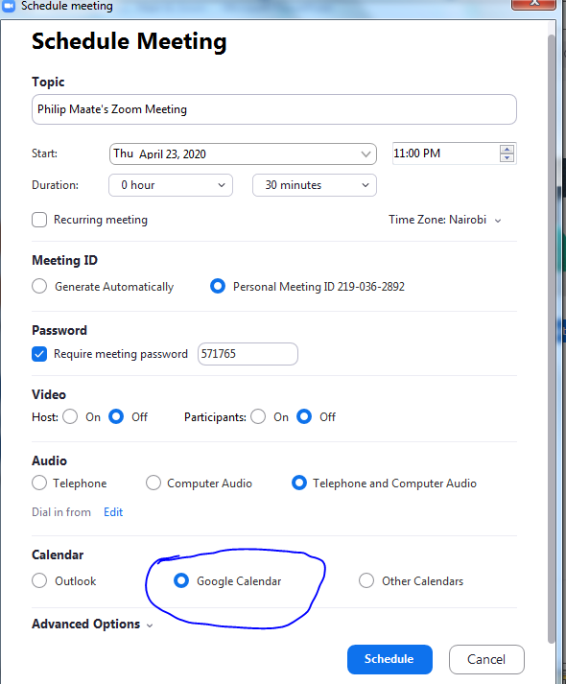
Click on scheduling a meeting to schedule a meeting or join a meeting to start a meeting
When done click schedule

Slide 10
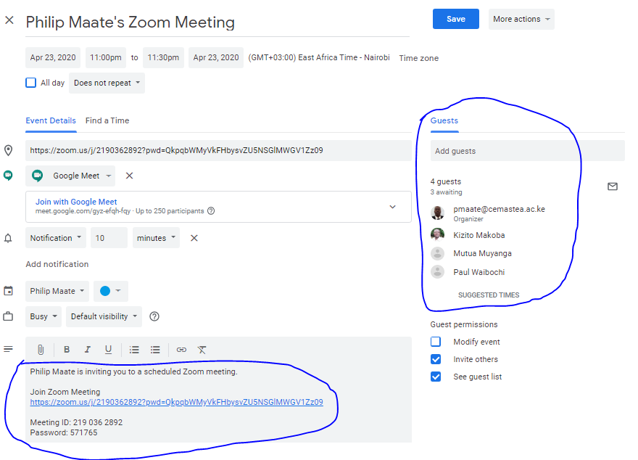
It will lead you to create a google calendar and make invitations to guests as shown

Slide 11
Once you click save all those invited (guests) will receive an email for the meeting
Thank you
Cheers!

