Slide 1
UNIT 3: DIGITAL TEACHING AND LEARNING MATERIALS
CEMASTEA

Slide 2
Recap
What new skills did I learn from Unit two?
Write your response in the chat area

Slide 3
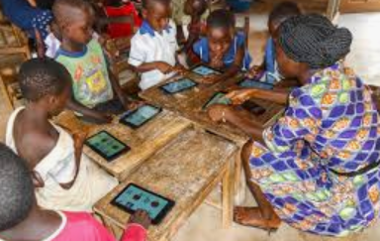
The focus of unit 3
Sourcing and developing digital learning resources

Slide 4
Rationale
Opportunity to bring your creativity and innovativeness in sourcing and developing digital learning resources.
Creating interactive and memorable learning experiences for your learners
Skills to source for digital learning resources and editing videos

Slide 5
Learning Outcomes
Identify media editing tools for making digital learning resources
Create digital learning resources for use in lessons
Appreciate the development of digital learning resources in enhancing learning outcomes.

Slide 6
How do we learn?

Slide 7
We shall practice:
Sourcing: Identifying, locating and selecting digital resource depending on a set criteria
Creating: The use of tools to produce an original learning resource
Editing: Reorganizing, modifying or adapting an existing resource to suit individual need

Slide 8
Where can you source for learning resources form?
Some examples:
https://phet.colorado.edu/
https://www.teachertube.com/
https://learn.khanacademy.org/khan-academy-kids/
http://www.tessafrica.net/
https://developer.ibm.com/digitalnation/africa/
Google drive apps e.g earth,podcasts

Slide 9
Sourced resources can be
Animations – making something look like it is alive.
Simulations – the imitation of the operation of a real-world process or system.
Text –Information on a given topic
Graphics- photos or diagrams
Audio- Sound only
Multimedia- text, audio, video and graphics

Slide 10
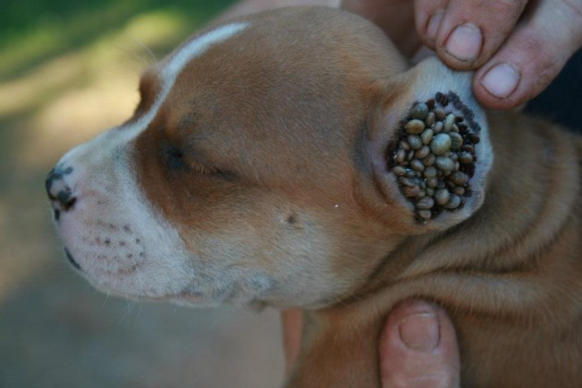
Examples: Teaching the idea of Parasites

Slide 11
Video showing evaporation and condensation

Slide 12
Creating
Simple ways of creating Digital materials include
Taking pictures
video capture
Audio capture
Editing /Manipulating

Slide 13
Example
What can you teach in your subject using this edited video?
Respond on the chat area

Slide 14
Editing
Let us now demonstrate how to edit a video
Requires the use of video editing software such as
Microsoft Windows Movie Maker
Avidemux Editing Software
Photos app (inbuilt)
PhoneVideo editor (download)
Research how to edit videos and apply the skills in editing using both the sourced and created clips
Self-created videos are better that sourced videos because, they are created with a clear purpose and objectives to achieve in using them.

Slide 15
Activities (in google classroom)
Shoot or source for a video of about 5 minutes in length and edit it to 2 minutes to enable you teach a concept in your subject.
Upload the original and the edited video
What did you consider when editing the clip in a) above to 2 minutes? Post your responses in the class stream

Slide 16
CONCLUSION
In this session we have looked at Digital learning resources
Sourcing
Creating
Editing
There is need to continue practicing the learned skills to become proficient in sourcing creating and using digital resources

Slide 17
Practice makes perfect-Keep practicing

