Slide 1
Endocrine System & Hormones
RECEPTION, RESPONSE AND COORDINATION

Slide 2
Lesson Objective
By the end of the lesson, I should be able to:-
Describe the endocrine system & hormones and their functions

Slide 3
Endocrine System & Hormones
The endocrine system is a collection of ductless glands found in/at various part of the body; the hormones they produce and the receptors in the body organs and tissues that recognize and respond to the hormones.
Hormones are organic compounds/chemicals which are either protein or steroids in nature. They are produced in minute quantities in cells in one part of the body and transported in the blood stream to the other parts of the same organism where they produce a response.
Hormones control physiological functions in the body including regulating metabolism, growth and development, tissue function, sexual function, reproduction, sleep, and mood, among other things.

Slide 4
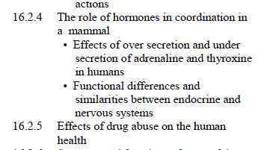
The Role of hormones in coordination in mammals

Slide 5
Quiz?
Name two hormones, state where they are produced and their functions?

Slide 6
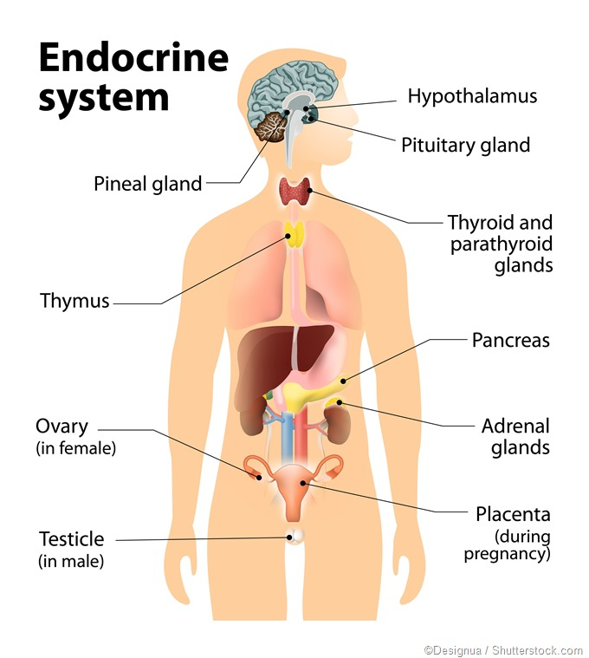
https://www.news-medical.net/health/Endocrine-Surgery.aspx

Slide 7
Thyroxine Hormone
Thyroxine hormone is produced by the thyroid glands found at the neck region.
Functions
Controls basal metabolic activities by increasing glucose oxidation
Enhances the effect of growth hormone (somatotrophin) that ensures normal growth and mental development.
It also works in conjunction with adrenaline hormone to enhance involuntary activities such as increased circulatory rates.

Slide 8
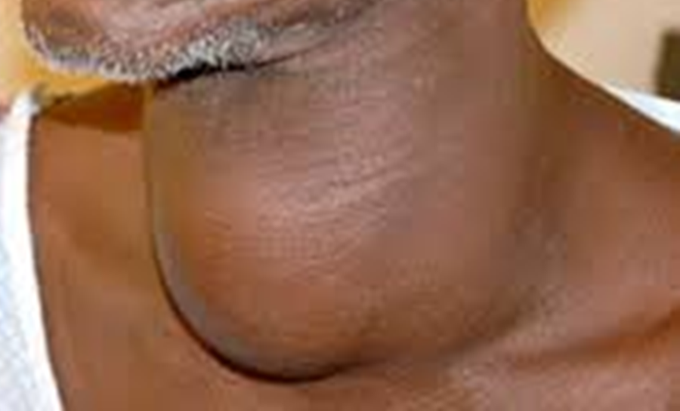
Underproduction Hypothyroidism
Mainly caused by insufficient iodine in the diet or defective enzymatic reaction concerned with its formation.
It leads to:
Cretinism in children
The children have deformed legs, dry leathery skin, large tongue, general body sluggishness and poor mental development resulting in low intelligence
Goitre
Goitre is the swelling of the thyroid, low metabolic rate as shown by reduced heart beat, breathing rate and body temperature; mental and physical sluggish, obesity

Slide 9
Overproduction Hyperthyroidism
Caused by the presence of plasma proteins that stimulate the thyroid activity i.e. defective enzymatic reactions.
Leads to increased metabolic rate resulting in increased heart beat, breathing rate and high temperatures.
Individual show nervousness, restlessness and are easily irritable
Extreme hyperthyroidism can lead to heart failure, a condition known as thyrotoxicosis.
Controlled by treatment with radioactive iodine or surgical removal of parts of the thyroid gland… Why?.

Slide 10
Adrenaline Hormone
Adrenaline hormone is produced by medulla part of the adrenal glands located above the kidney.
Functions
It prepares the body for emergency situations that require escape or defense (flight or fight ). It causes a series of physiological and metabolic activities such as
increases in the heart beat hence increasing rate of circulation.
Increases metabolic rate.
Constriction of the arterioles of the skin and digestive system…why?.
-In the liver, glycogen is converted into glucose at the liver…why?
-contract and relaxation of skeletal muscles to allow movement escape/fight.
-faster and deeper breathing rate
-converted of fats to fatty acids which are available in the blood for muscle contraction

Slide 11
Comparison between endocrine and nervous systems
What are the similarities and differences between nervous system and endocrine?

Slide 12
Similarities
means of communication within the body of an organism.
involve stimulus and a response
The target organs of hormones are like effector organs
involve chemical transmission.
bring about survival response.
Endocrine system | Nervous system
Chemical substance to evoke reaction | Nerve impulse to evoke response
Chemical transmitted through blood | Impulse only through nerve fibre
Response slow but could affect several parts of the body | Responses quick, specific and localized
Effects are long lasting | Effects are rapid and short – lived
Responses take place involuntarily | Rakes place voluntarily and involuntarily

Slide 13
Drug Abuse & it Effects on Human Health
Drug: Any chemical substance when taken into the body produces some psychological and physiological effects/changes (+ve and –ve).
Prescription Drugs: Well researched and documented drugs with expected +ve healing effects. Given in hospitals/chemists for a specific medical condition through a doctors/ physicians’ advice (prescription)
Drug abuse: It’s the indiscriminate and self/group prescription and use of drugs with no regard to medical advice and to their side –ve effects on the body and the person.
Commonly abused drugs include:
Nicotine, caffeine , cannabis Sativa/Bang, Marijuana, Khat (miraa), ‘Matembe’ and biscuits, Alcohol
Cocaine/ Heroine, steroids
Prescription abuse of pain killers(opiates) Cough Syrups

Slide 14
What do you know about the effects of drug abuse?

Slide 15
Prolonged abuse of drugs can cause addiction (drug dependence)…and many others
Diseases
May lead to cancer of the lungs, throat and that of urinary bladder, irritation of the lungs, respiratory tract & coughing and infections.
Damage to tissues of the heart and liver leading to heart attack and liver cirrhosis respectively., stomach ulcers
Irreversible damage to vital body tissues and organs and may eventually lead to death.
Behavioral
Addicted persons have an impaired judgment which may predispose them to accidents and infections such as HIV\AIDS.
Depressed appetite and poor feeding habits leading to emaciation
Brain damage leads to sleeplessness(insomnia), memory loss (amnesia), deliriums, hallucination and mental illness aka ‘muguruki’
Lowers nervous coordination leading to loss of posture and balance and decrease performance in sports and manual activity.
Developmental
In women, drug abuse may lead to poor foetal development and pregnancy complications.
Interference with absorption of vital vitamins such as vitamin K, E which may lead to sterility and blindness.

