Slide 1
UNIT 2: Using Teaching and Learning Management Systems for Remote Learning
Facilitators:

Slide 2
Session Flow
INTRODUCTION, RATIONALE, LEARNING OUTCOMES & EXPECTED OUTPUT- 10 MIN
EXPOSITION ON FEATURES OF GOOGLE CLASSROOM – 60 MINUTES
GUIDE ON ASYNCHRONOUS ACTIVITIES (CREATION AND USE OF A GOOGLE CLASSROOM) – 15MIN
CONCLUSION - 5 MINUTES

Slide 3
Introduction
This session explores the use of Learning Management System (LMS) in the learning process
LMS is an online system or software which is used to plan, execute, and assess a specific learning process
It serves as a virtual classroom where teachers can interact with their students and conduct learning activities online.
Examples include Google classroom, Microsoft Teams, Moodle and TalentLMS
In this session the focus is on Google Classroom

Slide 4
Rationale
LMS makes learning flexible since learning can take place anywhere and at anytime
Disruptions in the school calendar such as COVID-19 pandemic can occur leading to closure of schools.
This necessitates the need for LMS to allow continuity of learning.
LMS gives the teacher the ability to teach and track the progress of learners remotely.

Slide 5
Learning Outcomes
By the end of this unit you should be able to demonstrate ability to:
i. Navigate a Google classroom
ii. Create a Google classroom
iii. Add content to the created Google classroom
iv. Appreciate the use of Google classroom LMS

Slide 6
Google Classroom
How to join a Google classroom (10 min)
Log into your Gmail account
Respond to the email with the following Subject: ​Class Invitation:
Body: CEMASTEA - ICT TRAINING 2021
Click the button to accept the class invitation

Slide 7
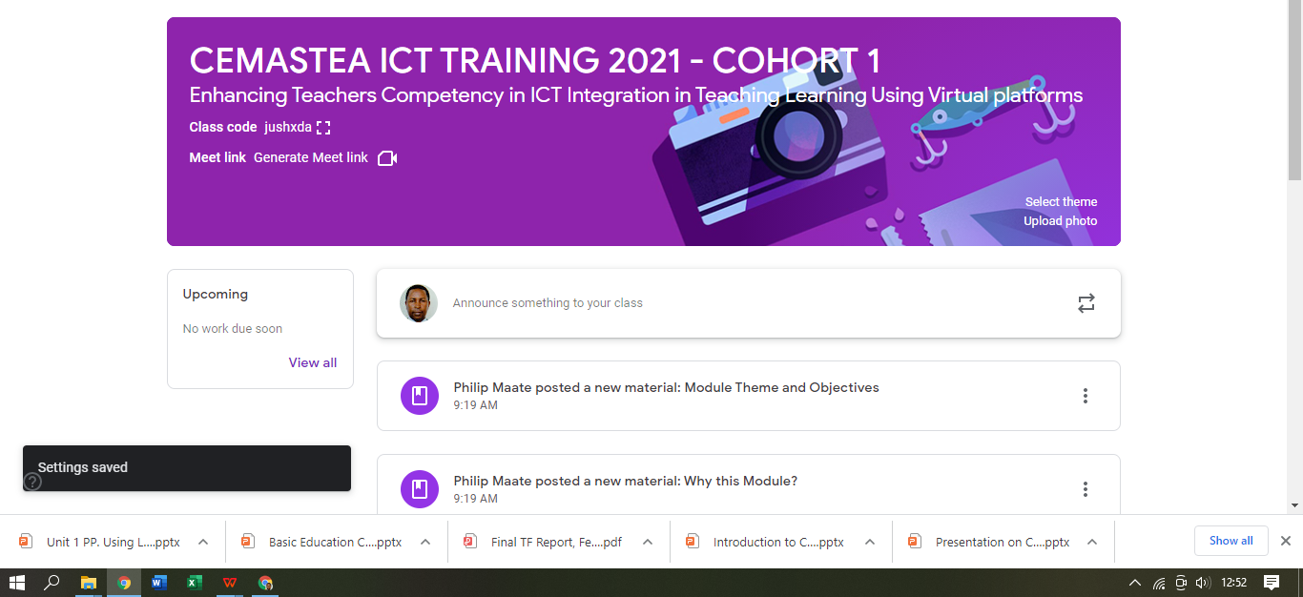
Class Home Page

Slide 8
Google Classroom on Mobile Phone
Google Classroom Icon

Slide 9
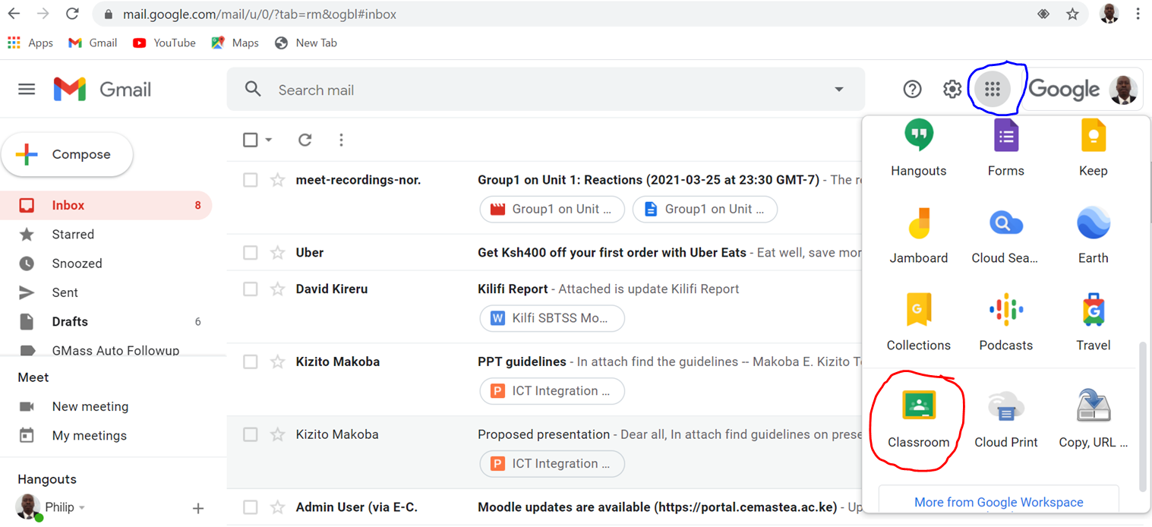
How to join a Google classroom - cont’d
Alternatively when logged into your Gmail click the apps (nine dots)

Slide 10
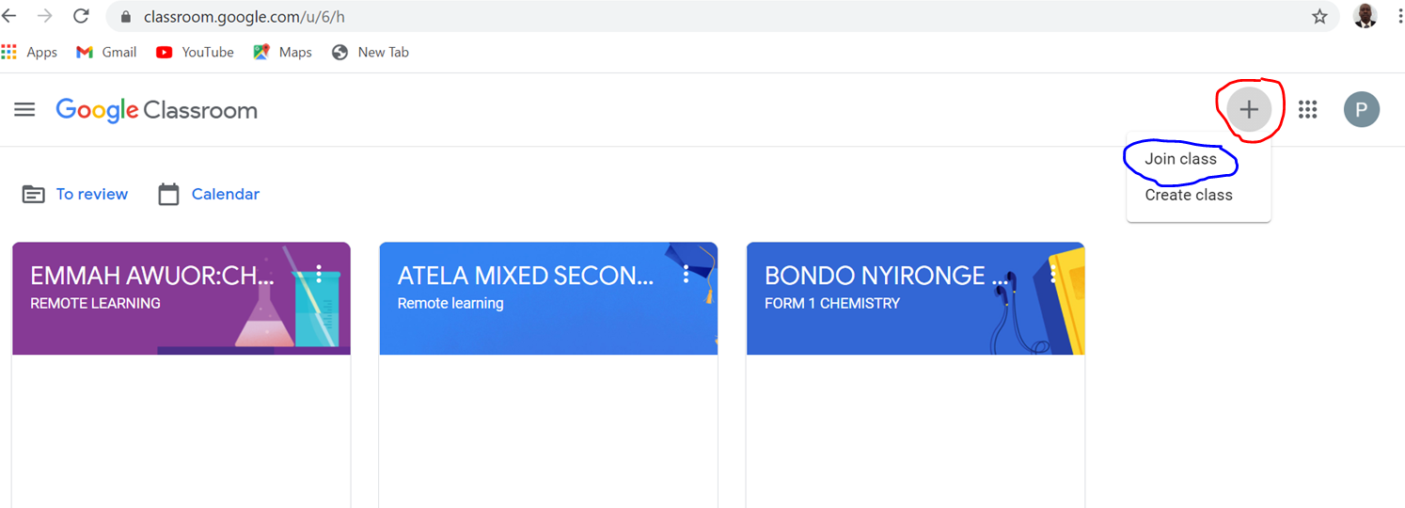
How to join a Google classroom - cont’d
Click on the google classroom icon, then click the + icon an select join class

Slide 11
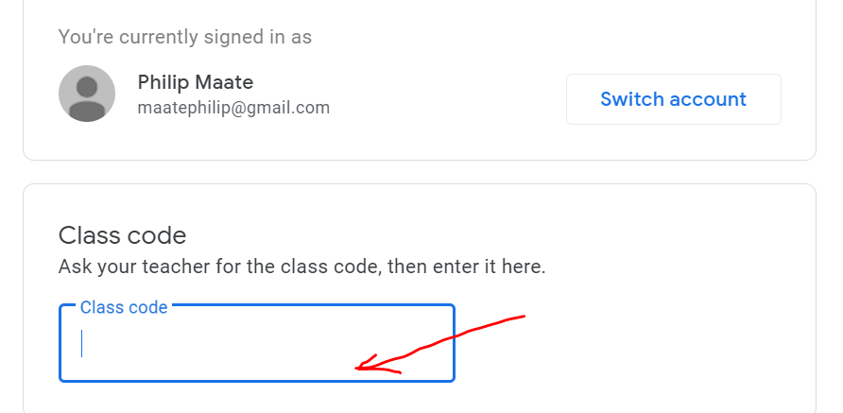
Enter the class code to join

Slide 12
Features of a Google Classroom(Demonstrate)- 30 min
Some of the features include
Stream
Under this tab both the teacher and the student can post announcements
Classwork
This tab enables you to post assignments and learning content.
It helps the teacher allocate marks to various tasks, as well as schedule the assignments
People
You can add or remove students as well a invite teachers to the class using this tab (as a teacher)
You are able to see the teachers and other classmates in class ( when you are a student).
It also provides an option for the teacher to email, remove or mute students.
Grade
The grades or marks awarded to students are displayed under this tab

Slide 13
Viewing Classwork/tasks
Click on the classwork tab
Then click on various tasks – Assignments, questions and reading materials; kindly respond to them
Lets walk through the various options in the platform

Slide 14
Responding to tasks
Under classwork tab click on any activity to view e.g. activity 1. You will see “class comments” and on the right “your work”.
You are expected to post your work under “your work” section
You can post a private comment here or click on “+ Add or Create” icon to get 7 options to use for your answer

Slide 15
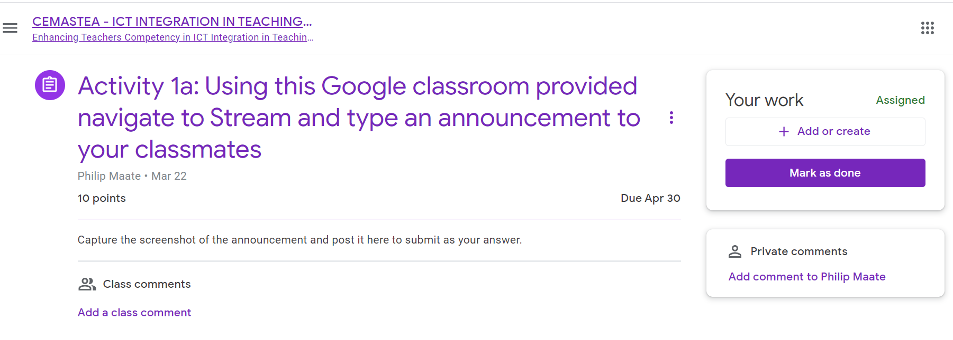
Responding to tasks

Slide 16
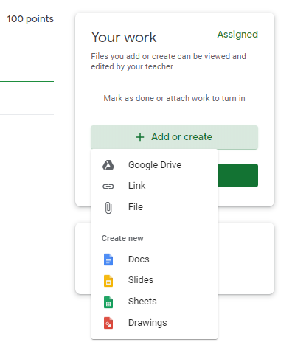
Posting your response

Slide 17
Posting your response
The options are
Google Drive – clicking it takes you to your google drive to select a resource stored there
Link – clicking gives you an options to paste a link
File – clicking gives an option to add a file from your device (computer or even your google drive)

Slide 18
Your Response Options
Creating New
Docs – clicking creates google docs (word processor) where you can write your response and post
Slides - clicking creates google slides (presentation) where you can write your response and post
Sheets - clicking creates google spread sheets where you can write your response and post
Drawings – Gives google drawing- you can draw diagrams, paste or insert pictures, etc.

Slide 19
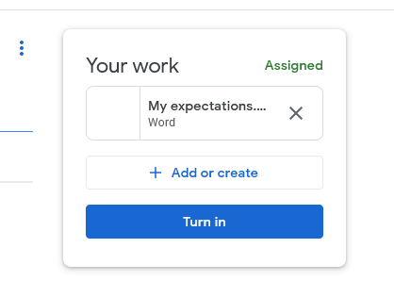
Completing your assignment
After selecting appropriate option and answering, click Turn in

Slide 20
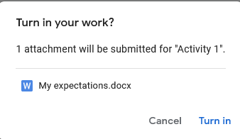
Completing your assignment
After clicking Turn in, this popup window will emerge
Click “Turn in” to submit your assignment

Slide 21
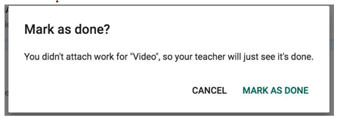
Completing Assignment
You can complete your assignment without attaching a file
Just click MARK AS DONE

Slide 22
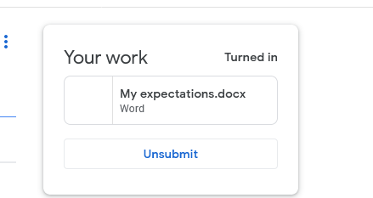
Completing submission
After submitting this window will emerge
To edit your work you can always click “Unsubmit” icon and edit

Slide 23
Navigating google classroom is easy
Take your time to familiarize yourself with other functionalities

Slide 24
Guide on Asynchronous Activities
You are expected to do activities 1a, 1b,1c and 2 in the Google classroom and adhere to the deadlines set.

Slide 25
Conclusion
In this session you have learnt the features of a Google Classroom, how to create and use the Google Classroom for teaching and learning
It is now expected that you will practice this skill and use it to teach your learners remotely or blend it with face to face to engage them and give them tasks or assignments to enhance achievement of learning outcomes

