Slide 1
Impulse Transmission across a Synapse/Neuro-junction
RECEPTION, RESPONSE AND COORDINATION

Slide 2
Synapse/Neuro-junction

Slide 3
Lesson Objectives
By the endo of the lesson, you should be able to
Describe the structure of a synapse
Describe how a nerve impulse is transmitted across a synapse

Slide 4
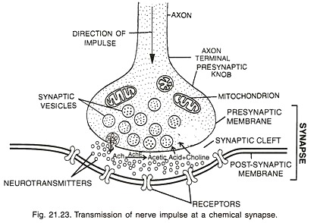
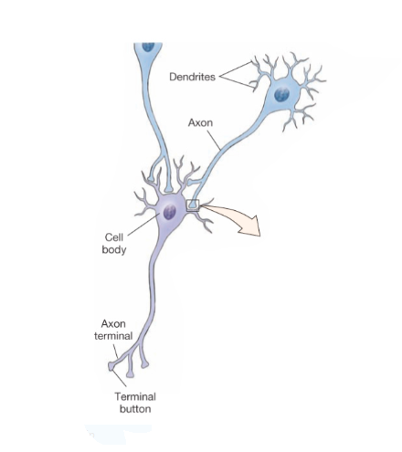

Slide 5
Structure of the Synapse
A synapse is a point at which two nerve cells come into contact. At this point, a dendrite from one of the nerve cell forms an enlargement called a synaptic knob.
The function of the synapse is to allow the transmission of nerve impulses from neurone to neurone.
The transmission of impulses across a synapse enable by a a chemical called neuro-transmitter/acetylcholine.
The neuro-transmitter is found in numerous sac-like structures called synaptic vesicles. Synaptic knob contains and mitochondria.
The terminal part of the synaptic knob is pre-synaptic membrane while the membrane of the adjoining nerve cell is post-synaptic membrane.
Between the two membranes is a gap called the synaptic cleft.

Slide 6
Transmission of an impulse
When an impulse reaches the synaptic knob, it stimulates the vesicles to move towards the pre-synaptic membrane releasing neuro-transmitter substances (acetylcholine).
Acetylcholine diffuses across the synaptic cleft to the post-synaptic membrane which then becomes depolarized. Na+ ions from the cleft then flow through the post-synaptic knob causing an action potential. The action potential is then transmitted as a nerve impulse along the next neurone.
Immediately afterwards acetylcholine at the synaptic cleft is broken down by an enzyme called cholinesterase into inactive end products (choline and acetic acid) These are then reabsorbed by the axon terminals and reconstituted into acetylcholine using energy provided by mitochondria.

Slide 7
Accommodation of synapses
If a synapse is stimulated continuously for a long time, a point comes when no impulses are transmitted in the post-synaptic neurone.
The synapse is then said to accommodate or adapt to the stimulus.
Example: When one wears a rough shirt, an unpleasant sensation is initially felt. After sometime the sensation is not felt any more.
Accommodation results from exhaustion of the neuro-transmitter which cannot be synthesized as fast as it is required.

Slide 8
Synaptic inhibitors
These are the substances that interfere with transmission of nerve impulses across the synapse e.g.
Most of them are chemical substances such curare (ever heard of poisoned arrows). They block the post-synaptic membrane preventing it from being stimulated by neuro-transmitter substances
Others like organophosphates e.g. malathion inhibit enzyme cholinesterase preventing destruction of acetylcholine leading to overstimulation of the post-synaptic membrane
Snakes also produce neuro toxic poisons that affect the

Slide 9
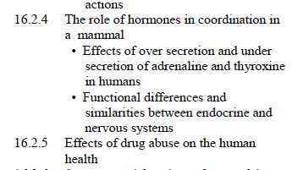
The Role of hormones in coordination in mammals

