Slide 1
UNIT 1: VIRTUAL MEETING PLATFORMS FOR REMOTE LEARNING
FACILITATOR

Slide 2
Session Flow
Introduction 2min
Rationale 3min
Learning outcomes 2min
Expected output 3mn
Microsoft Teams 70 min
Conclusion 10min

Slide 3
Introduction
Virtual platforms provide real-time interactions.
Examples of these platforms include Cisco Webex, Google Meet, Microsoft Teams, WhatsApp, BigBlueButton.
They transmit audio, video and text.
In this training, you will use Microsoft Teams platform, to enhance your ability to hold virtual meetings as well as teaching and learning.

Slide 4
Rationale
Digital literacy needed for the 21st century- living in information age
There has been increased demand for use of online platforms for meetings, conferences, etc.
One of the core competencies in CBC is digital literacy
This session will enhance your capacity to use Microsoft Teams in teaching and learning.

Slide 5
Learning outcomes
By the end of this unit, you will be able to:
Use Microsoft Teams to facilitate teaching and learning process
Demonstrate understanding of the features of Microsoft Teams in teaching and learning.
Aspire to use virtual meeting platforms for meetings and learning processes

Slide 6
Expected Outputs
Individually Created and Scheduled Microsoft Teams meetings
Invited members into the meeting
Virtual meetings conducted

Slide 7
Accessing Microsoft Teams
Explain how you can access Microsoft Teams.
Post your response on the chat

Slide 8
Accessing Microsoft Teams
You can access the Microsoft Teams in the following ways:
TSC website homepage
The MS Team App
downloaded app on laptop
playstore or appstore
Microsoft Teams browser
In this session we will demonstrate accessing using the TSC website

Slide 9
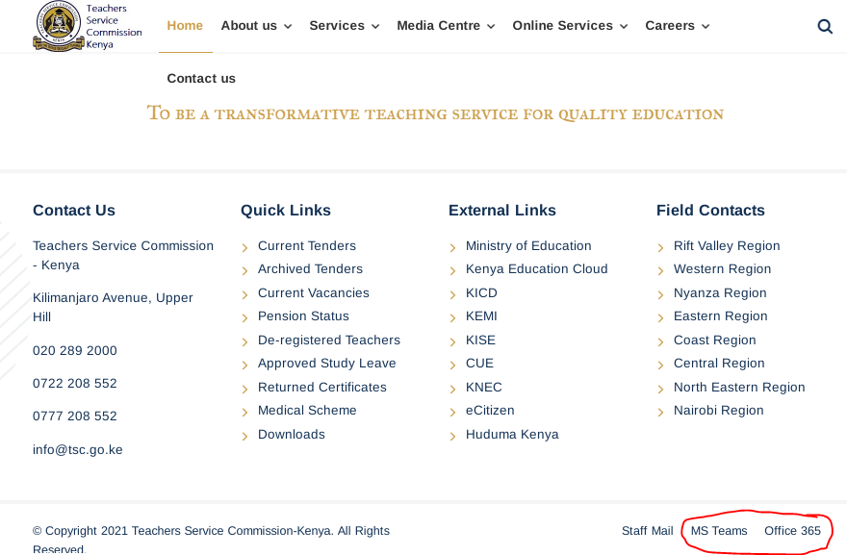

Slide 10
Navigating Microsoft Teams
Accessing different icons
Creating a meeting
Inviting participants
Chat area
Recording.
Presenting
NB. Navigate with phone and computer

Slide 11
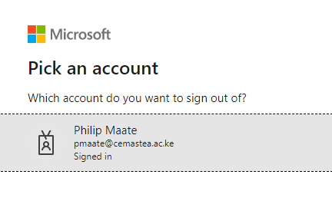
Sign in to Microsoft Teams

Slide 12
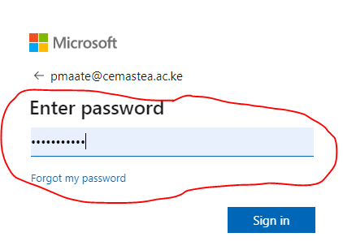
Type password

Slide 13
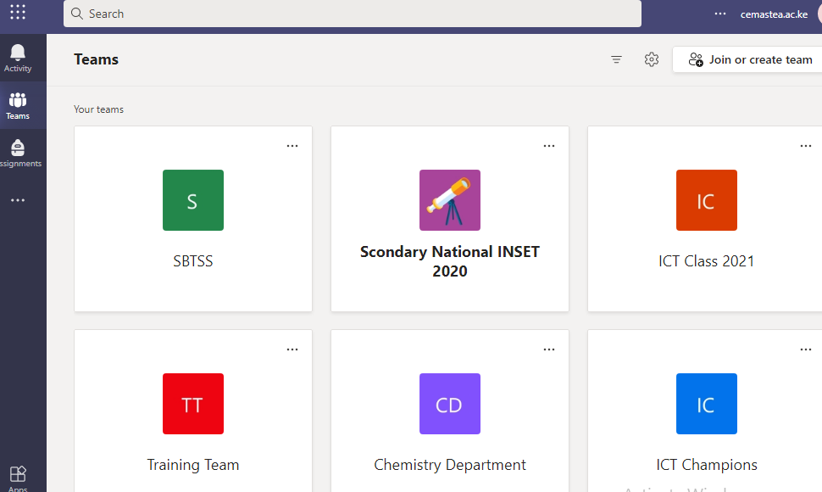
Once logged in

Slide 14
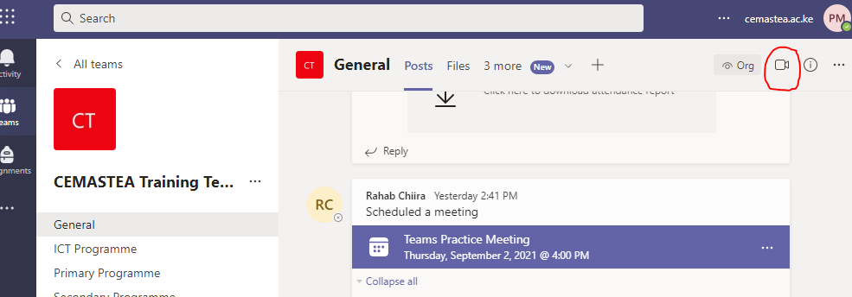
Starting a meeting

Slide 15
Meeting

Slide 16
Accessing various options
Try all the options in the menu ribbon as shown below

Slide 17
Activity 1
a) Create a meeting using Microsoft Teams
b) Invite participants to your meeting
NB: You can schedule a meeting instantly or using the calendar; Explore
Upload a screen shot for your meeting as your output here

Slide 18
Conclusion
In this session, we have looked at Microsoft Teams
You can access Microsoft Teams through the TSC website
This short exposure has given you insights and desire to explore more.
You are encouraged to continue sharing new ideas with colleagues and other people involved in education.
This shall improve your professionalism as well as build robust communities of practice.

Slide 19
THANK YOU

